Slide 1
TIME-DEPENDENT POWER FLOW MODELING FOR NON-PASSIVE LOADS IN BATTERY ELECTRIC PROPULSION ARCHITECTURES
Nicholas A. Ingarra, PhD, P.E. ¹, Krzysztof (Chris) J. Kobus, PhD², Jadon G. Kobus²

Slide 2
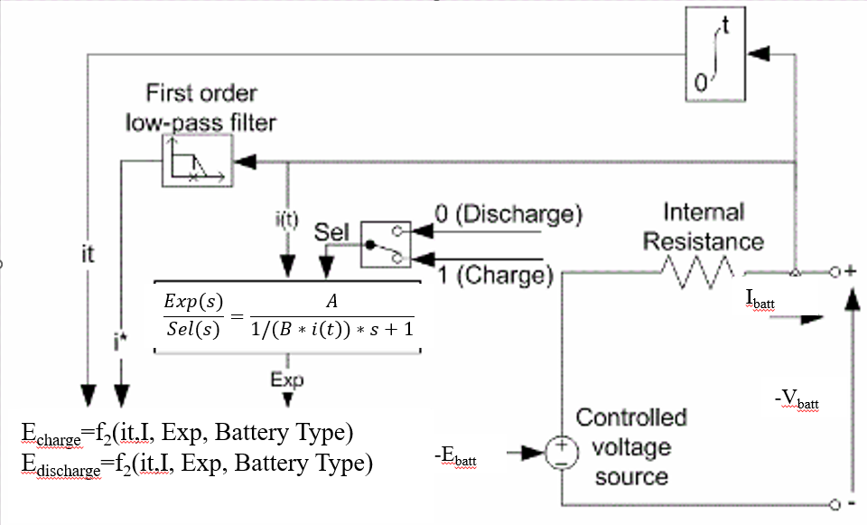
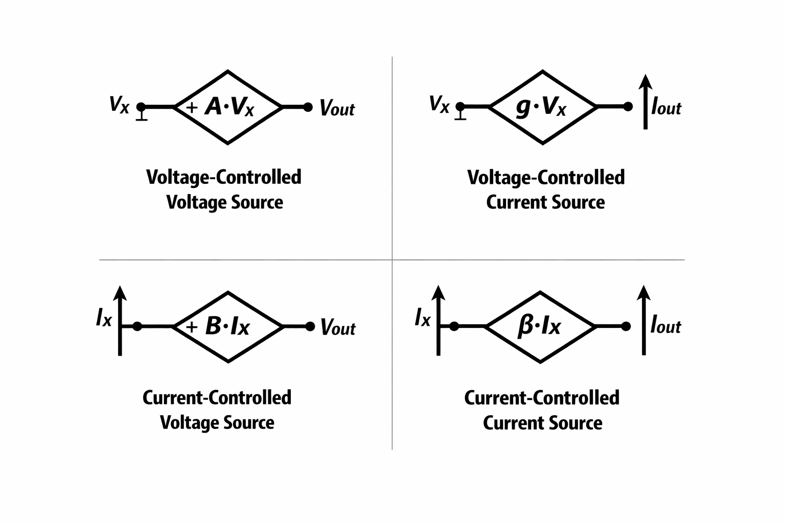
| What is a Battery?
Battery Model
Dependent Sources
*Non-passive power flow relies on controlled idea sources to model feedback loops
Is it a current controlled voltage source (CCVS)?
Is it a current controlled current source (CCCS)?
Is it a voltage controlled voltage source (VCVS)?
Is it a voltage controlled current source (VCCS)?
2

Slide 3
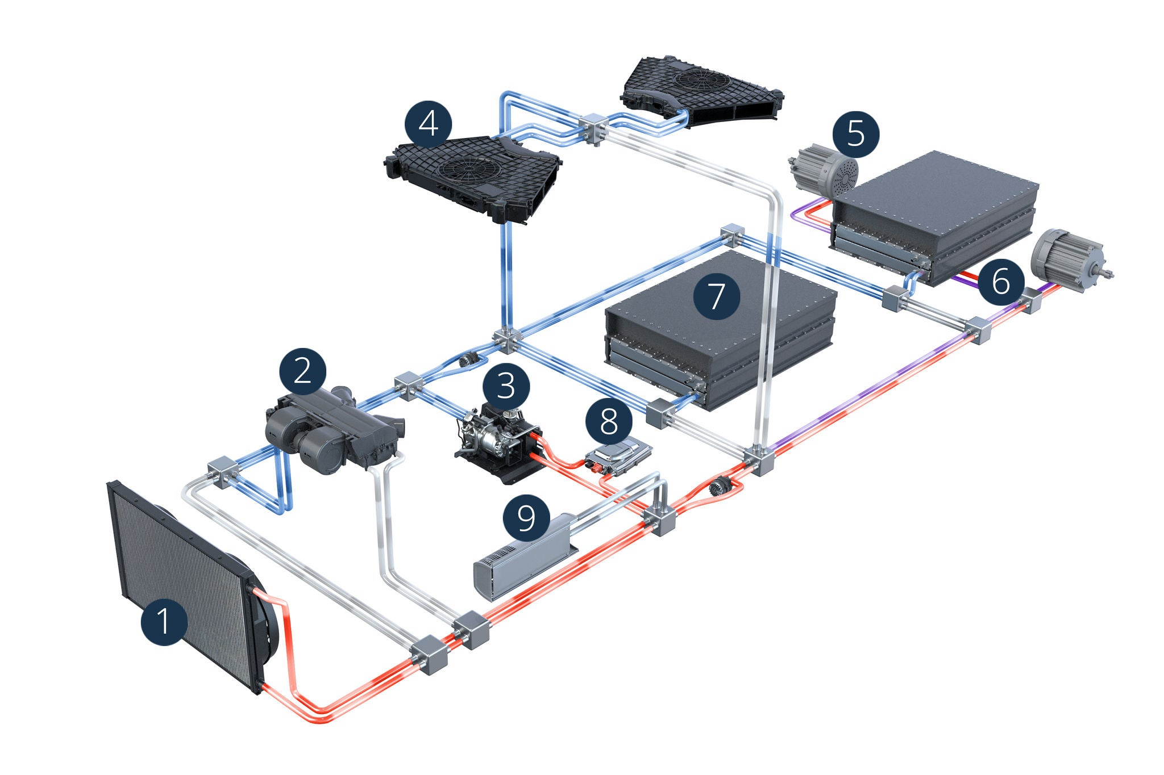
| Executive Summary
Problem:
Battery-only electric power systems are not steady-state devices. Manufacturer data relies on static internal impedance, omitting transient heat generation.
There are several battery models that can be used with varying accuracy.
      Batteries are known to have 3 distinct discharge modes.
    Solution:
Electrical and thermal models must be inherently coupled to accurately size Battery Thermal Management Systems (BTMS) and predict performance.
3

Slide 4
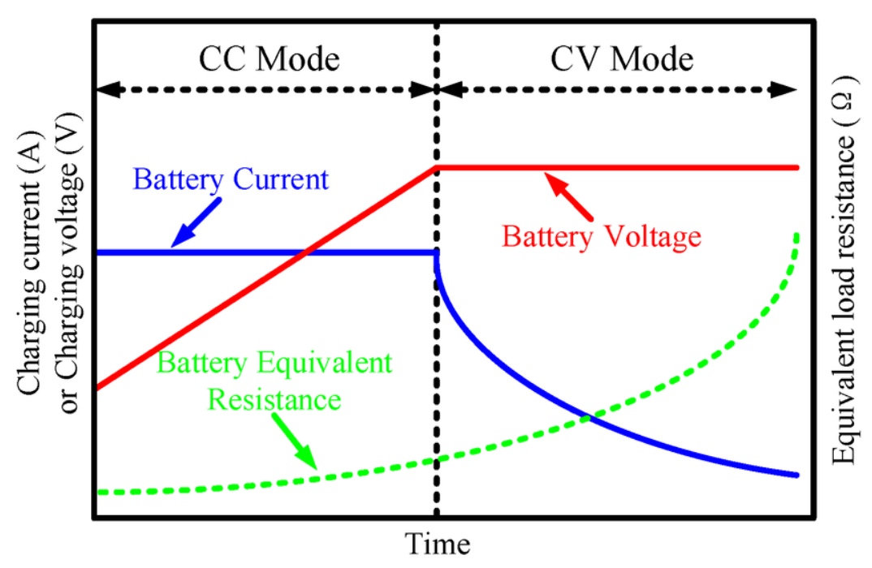
| Technical Summary
Batteries in electrical power systems are not steady-state devices and must be modelled as a transient (time-dependent) device.
When the battery is the sole power source, we must rely on the raw form of conservation of energy.
Batteries discharge in 3 distinct modes: Constant Current (CC), Constant Power (CP), and Constant Resistance (CR)
4

Slide 5
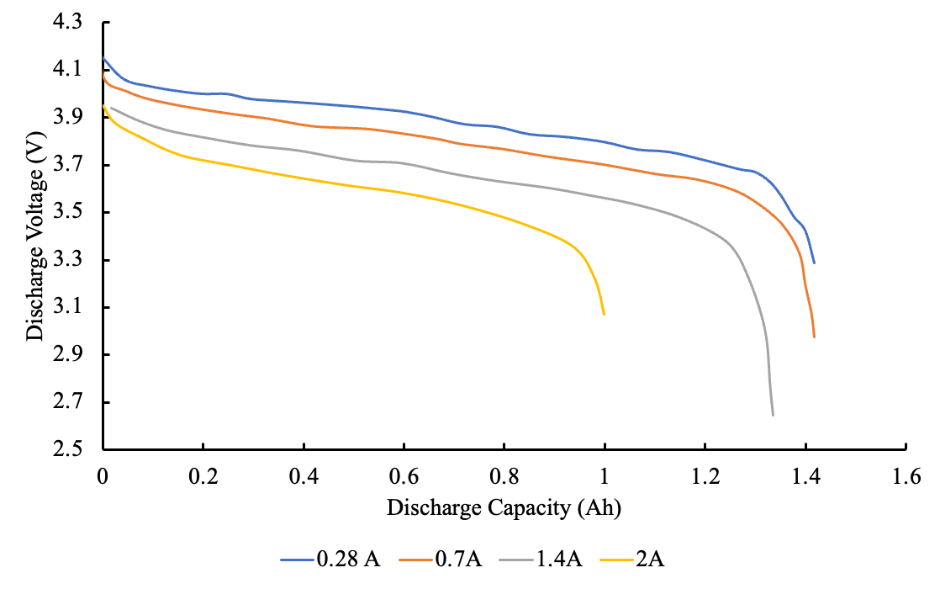
| Overview of Modeling Power Systems
Hybrids can control State of Charge (SOC) to maintain the optimal 20%-80% window; BEVs (non-hybrid) experience full-depth discharges, behaving differently because the state of charge of the battery cannot be maintained.
Using Linear Circuit Analysis (LCA), the power delivered decreases due to decrease in cell voltage.
Cell performance and efficiency changes with the state of charge of the battery.
If performance is required (such as in a traction drive motor), the battery will discharge under constant power. This will lead to lower capacity and higher heat generation.
Lower input voltage will require more current leading to depleting the battery quicker.
Constant current (C-rate) does not mean constant power
Sample Discharge Curve
5

Slide 6
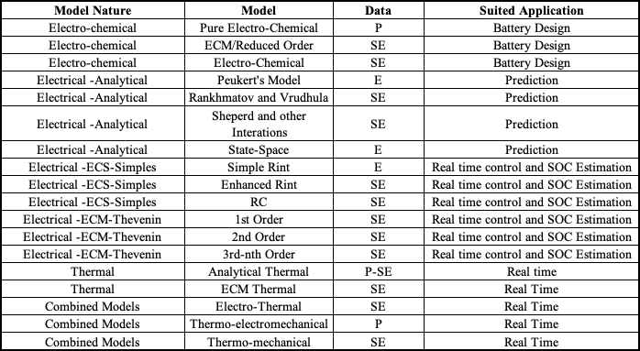
| Types of Battery Models
6
Notes:
There is not a single battery model that does everything

Slide 7
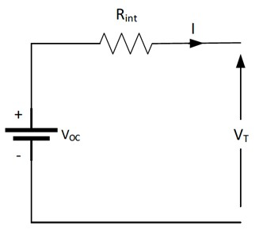
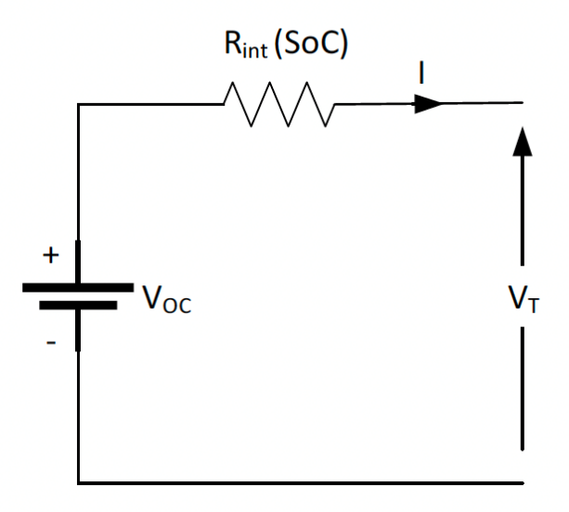

| Types of Battery Models
Simplified Battery Cell Model
Enhanced Battery Cell Model
7
Notes:
Note the enhanced model reflects how the resistance changes with state of charge, both of these models are using KVL

Slide 8
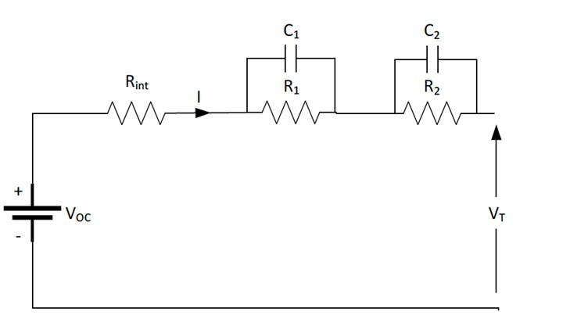
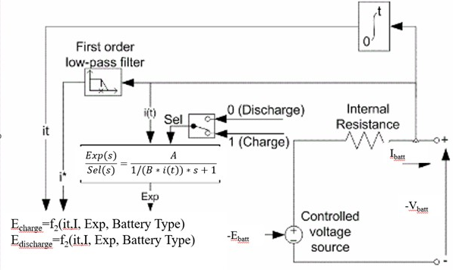
| Types of Battery Models
Second Order Thevenin Model
MATLAB & SIMULINK Model
8
Notes:
More complex models, the capacitors are approximating the electrode, but the Thevenin is used for SOC estimation, The MATLAB model is using KVL a

Slide 9
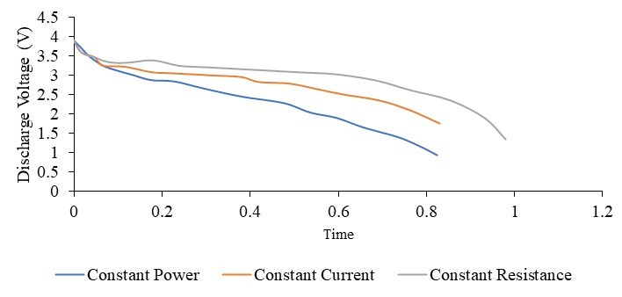
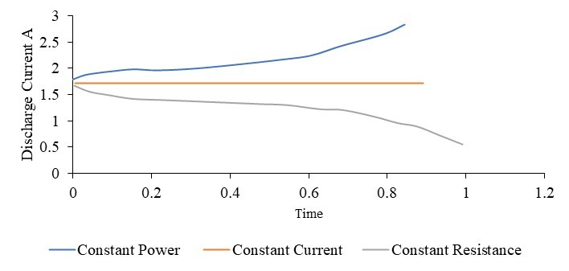
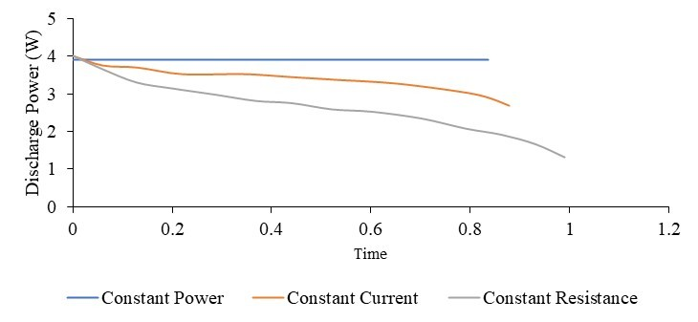

| Different Discharge Modes
Voltage
Current
Power
Constant Current does not provide constant power
Constant Power will not have constant voltage
9
Notes:
Constant current will not maintain power
Constant power current adjusts to keep power constant

Slide 10
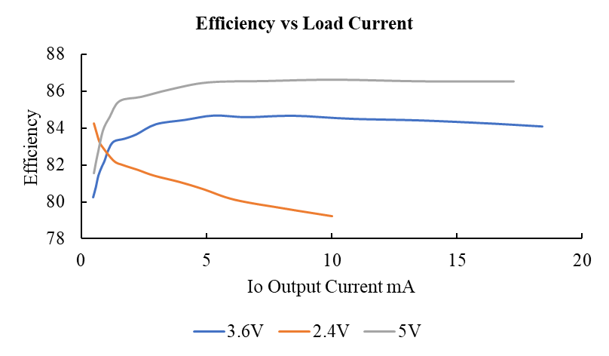
| Power Electronics Efficiency
Input Current
Input Voltage
As input system voltage decreases, efficiency decreases
As output/load current increase, efficiency decreases
As load on Power electronics, load increases, efficiency decreases
10

Slide 11
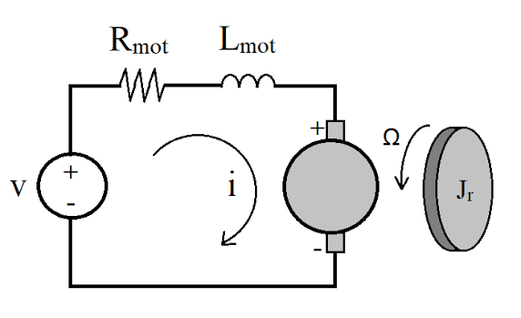

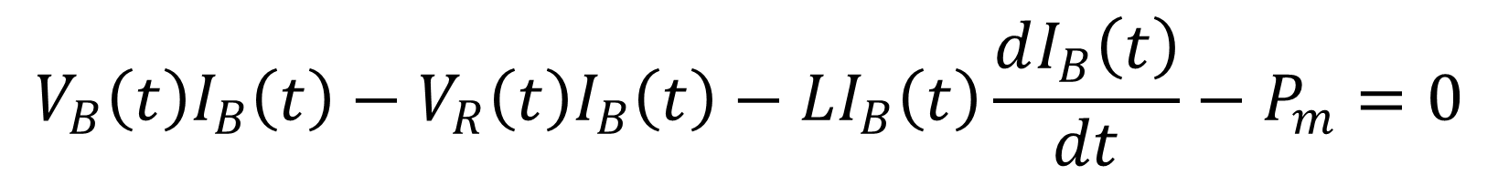
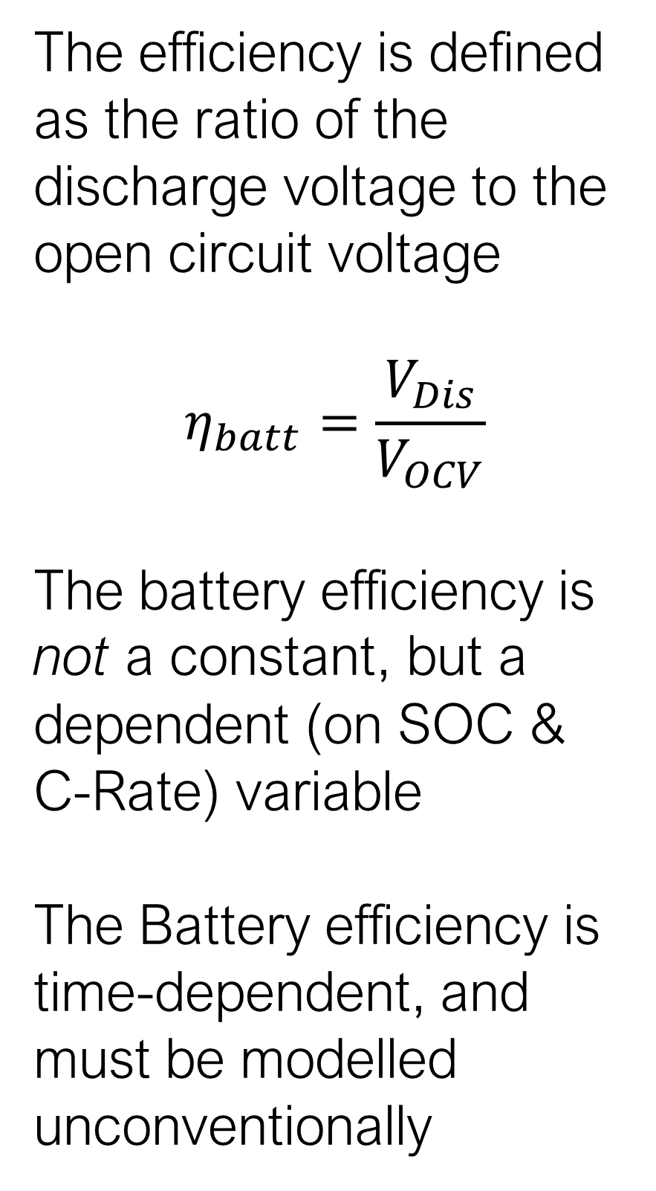
| Electrical Motor Model
The efficiency is defined as the ratio of the discharge voltage to the open circuit voltage
$$η_{batt}=\frac{V_{Dis}}{V_{OCV}}$$
The battery efficiency is not a constant, but a dependent (on SOC & C-Rate) variable
The Battery efficiency is time-dependent, and must be modelled unconventionally
Variable Voltage Circuit Model:
Constant Voltage Circuit Model:
$$V_{B}\left(t\right)I_{B}\left(t\right)−V_{R}\left(t\right)I_{B}\left(t\right)−LI_{B}\left(t\right)\frac{dI_{B}\left(t\right)}{dt}−P_{m}=0$$
$$V_{B}I_{B}−V_{R}I_{B}−LI_{B}\frac{dI_{B}}{dt}−P_{m}=0$$
11

Slide 12
| Conclusion
  1. Kirchoff’s Voltage Law (KVL) is merely a special case of the conservation of energy.
  2. When a battery is the sole power source, strict KVL modeling falls short; batteries will discharge constant power.
  3. We must apply the raw Conservation of Energy to accurately map transient (time-dependent) power flow.
12

Slide 13

| Thank you!
Any Questions?

